Slide 1

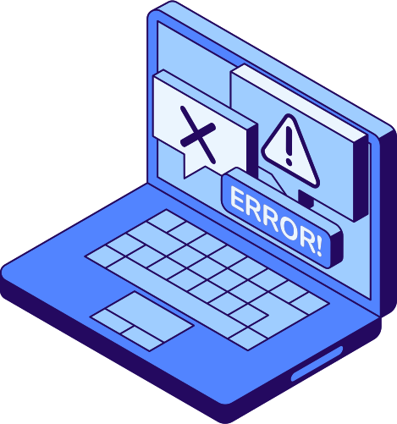
01/13
CHILD GROOMING
DETECTION
By
Kushal Pasumarty - GY76933
Preetham Kadiyam - FG32258
Sivateja Gopinatham - ZO27532

Slide 2


INTRODUCTION
02/13
Understanding the Threat: Child grooming exploits minors by building trust and isolating them. Detecting such behavior is vital for safety.
The Importance of Detection: Grooming is increasingly subtle with rising online interactions. Early detection helps prevent exploitation.
Our Focus: This project uses AI to analyze conversations, identify grooming cues, and provide actionable insights.

Slide 3

OBJECTIVE
03/13
To develop a system that detects potential grooming behaviors in online conversations using advanced AI models. The system analyzes text, identifies patterns, and evaluates risk.
Actionable Insights: Provide users with a detailed risk score, matched patterns, and an explanation to ensure clarity and informed decisions.
Our Goal: To leverage AI technology to safeguard vulnerable individuals by identifying and mitigating grooming behaviors effectively.

Slide 4

METHODOLOGY OVERVIEW
04/13
Robust multi-stage pipeline for detecting grooming behaviors.
Developed a versatile knowledge base, enriched with both static and dynamic patterns.
Leveraged LLMs for classification and semantic embedding tasks.
Employed FAISS for high-speed retrieval of semantically similar patterns.
Designed a risk assessment framework with dynamic weighting.

Slide 5



KNOWLEDGE BASE
05/13
Constructed a foundational database with grooming-related behavioral cues.
Enhanced dynamically using Retrieval-Augmented Generation (RAG) for contextual relevance.
Incorporated semantic embeddings and FAISS for efficient pattern retrieval.
Ensures scalability and adaptability with minimal manual updates.
Examples include: “You’re so mature for your age”, “Let’s keep this between us”.

Slide 6
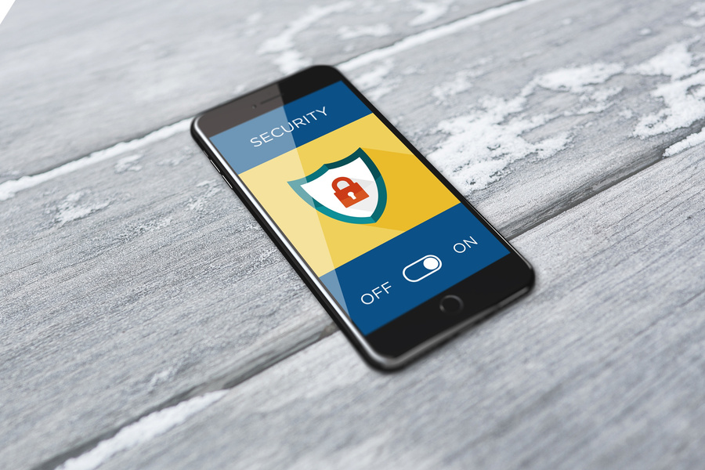

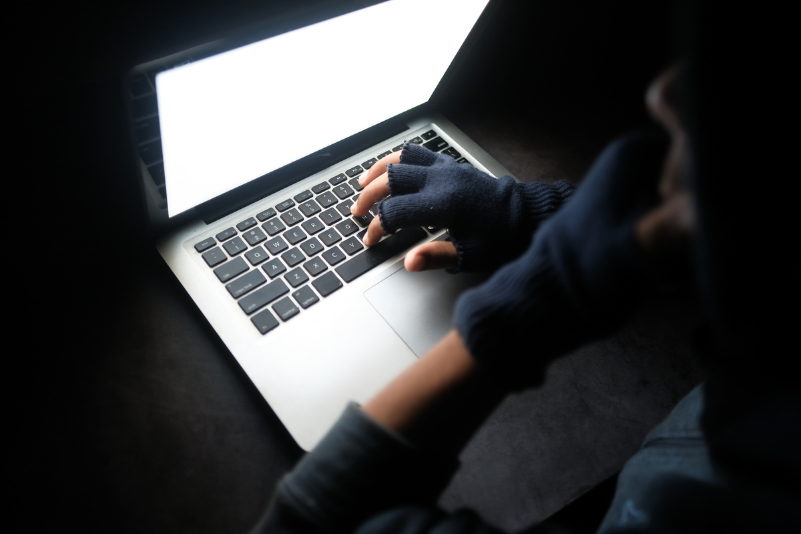

MODELS USED
06/13
Semantic Embedding
Text Classification
Integrated sentence-transformers/all-mpnet-base-v2 for contextual analysis.
Deployed bloomz-1b7-mixed-detector for accurate behavior detection.
FAISS Indexing
LangChain Framework
Enabled fast, scalable retrieval of semantic patterns.
Implemented RAG for real-time pattern augmentation

Slide 7
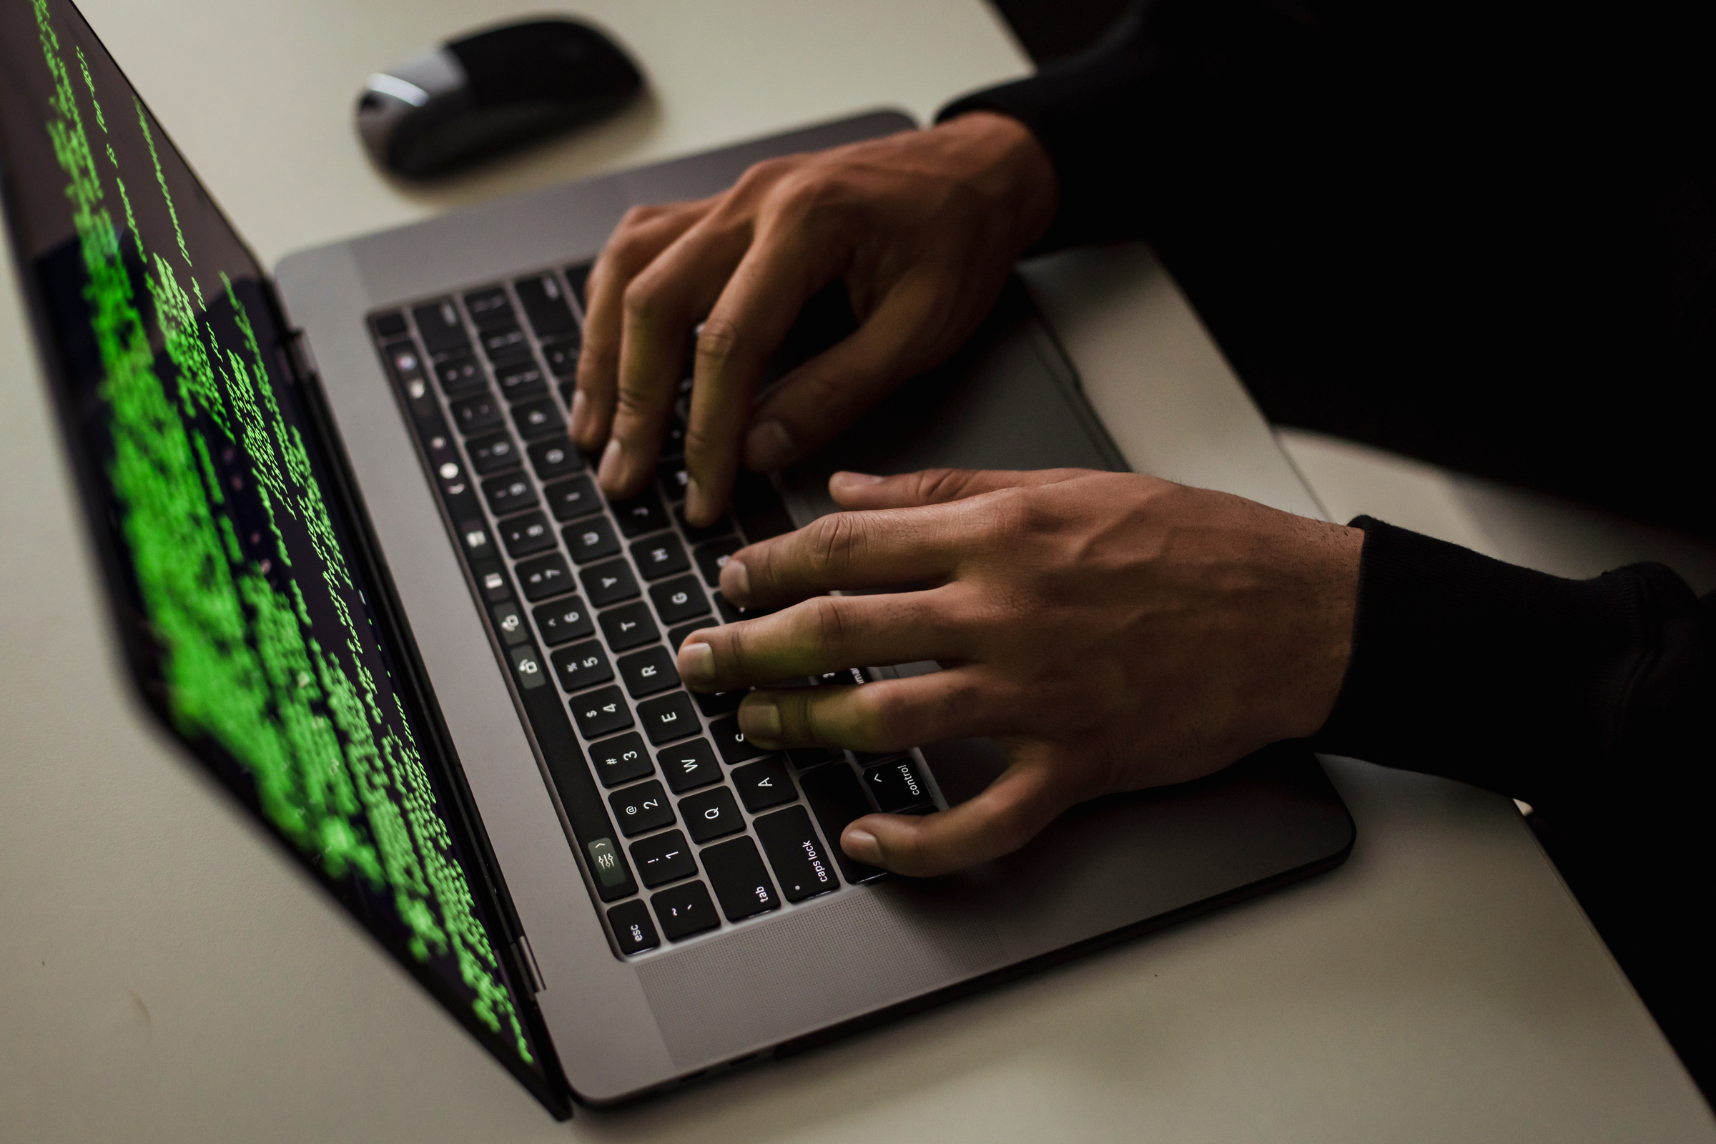
RISK SCORING MECHANISM
07/13
A hybrid scoring model combining pattern detection, secrecy cues, and manipulative language.
Weighted scoring to reflect the severity of grooming behaviors.
Generates a capped risk score (0-10) for clarity and interpretability.
Provides in-depth explanations based on detected patterns and risk levels.
Example: “Detected behavioral patterns suggest trust-building and boundary testing.”

Slide 8
SAMPLE CHAT FOR TESTING
08/13
User1: Hi! You seem really interesting. I’m glad I found someone cool to talk to.
User2: Oh, thanks. That’s nice of you to say.
User1: No problem. I just like connecting with nice people online. It’s kind of rare.
User2: Yeah, I guess it is. What do you usually talk about?
User1: Anything fun—hobbies, secrets, stuff like that. I like deep conversations.
User2: Secrets? Like what?
User1: Just things people don’t normally share. It’s cool when someone trusts you enough to open up.
User2: I don’t know if I have any interesting secrets.
User1: That’s okay. I bet you do, though. We could talk more, and maybe you’ll think of something.
User1: I’d love to hear about your life. What makes you happy or even scared? Sometimes sharing that stuff feels nice.

Slide 9
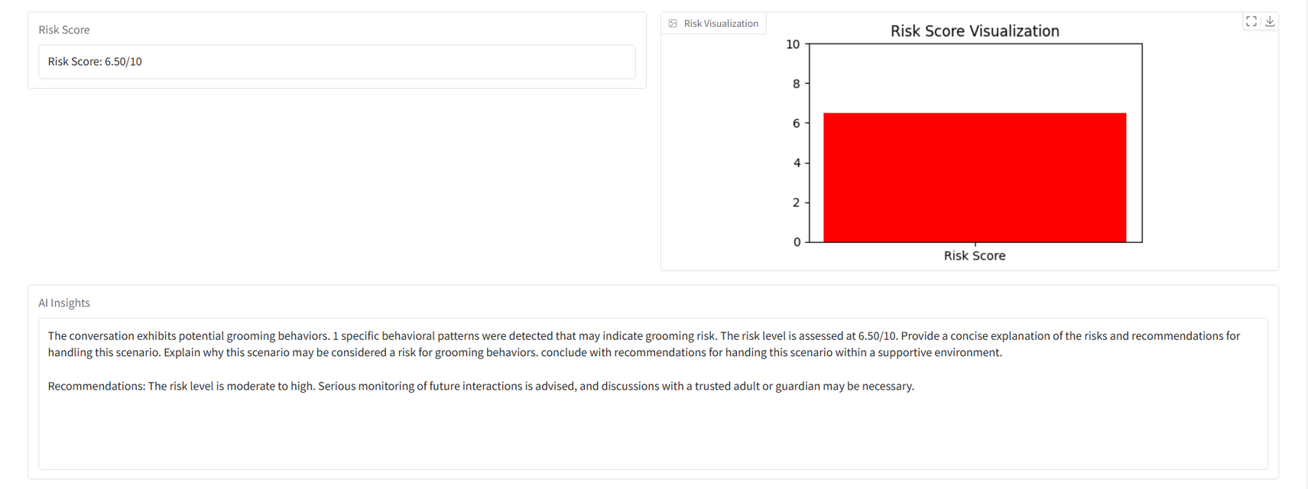
RESULTS & OBSERVATIONS
09/13
Model has predicted the chat with a score of 6.5 out of 10, which is 95% accurate.
Result is not only depicted in a numerical format but also in visual format.

Slide 10

10/13
Data Scarcity: Limited availability of publicly accessible datasets on child grooming made it challenging to fine-tune models effectively.
PROBLEMS FACED
Balancing Sensitivity and Accuracy: Setting thresholds for pattern matching and risk scoring was complex, as overly sensitive settings caused false positives
Dynamic Knowledge Base Challenges: Integrating RAG for real-time knowledge base expansion introduced performance overhead and required tuning

Slide 11
11/13
Expanded Datasets: Incorporate larger, diverse datasets to improve accuracy and adaptability across scenarios.
FUTURE WORK
Emoji Detection: Add capabilities to interpret emojis and their contextual meanings, and to detect how people are using it for various meanings.
Real-Time Monitoring: Enable real-time detection to flag grooming behaviors instantly for quicker intervention.

Slide 12
CONCLUSIONS
12/13
01
02
03
Empowering Safety
Promoting Security
Boarder Impact
The tool detects grooming behaviors, ensuring protection across platforms for all ages.
Identifying harmful patterns helps create safer and more trustworthy digital spaces.
The approach can extend to detect other harmful behaviors, enhancing online safety.

Slide 13
13/13
THANK
YOU!

